Slide 1

VOICE
MODULATOR
ECE 372A – MICROCONTROLLER ORGANIZATION
ELECTRICAL AND COMPUTER ENGINEERING
UNIVERSITY OF ARIZONA
SPRING 2019

Slide 2
TEAM
MEMBERS
Team 16
JACOB BOWLES
JESSICA SOFKA
NADINE NAJDAWI
LENA VOYTEK
Number Pad
Wave Modulator
Wave Modulator
Mechanical Layout
Audio In
Wave Modulator
Audio Out
Screen
Wave Modulator

Slide 3

STATEMENT
OF
PROBLEM
Voice modulation is extremely common - especially in the entertainment and music industry. Benefits of this technique include everything from quick audio fixes to turning an off-tune singer to a pop virtuoso.
AKA “autotune”
One of the biggest issues with voice modulation and amplification is minimizing as much feedback as possible while providing a clear output.
N
Notes:
We are implementing a voice modulator that takes in audio, using a microphone amp, and modulates the frequency and volume of that data depending on what the user chooses on the numeric keypad. An LCD screen will display various images to represent different settings selected via the numeric keypad. Voice modulation data will be outputted to a speaker. It will maintain a clear output, while minimizing feedback. We are using modulated data to fine-tune the pitch.

Slide 4
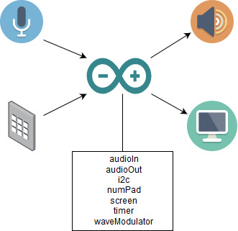
PROPOSED
PROTOTYPE
SOLUTION
Voice Modulation
The manipulation of pitch through wavelength modulation
Numpad for controlling voice effects for corresponding sound
LCD Output for displaying voice control settings from numpad
JB

Slide 5
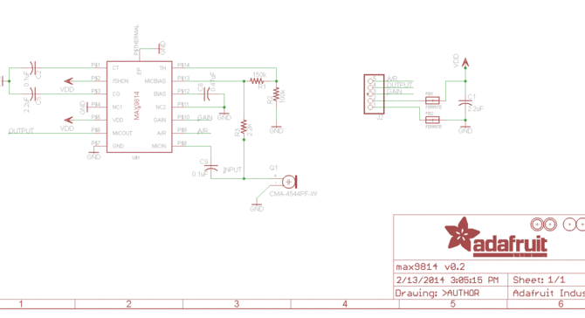
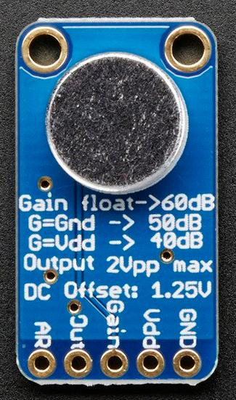
SENSOR TYPES
Adafruit Electret Microphone Amplifier - MAX9814
L

Slide 6
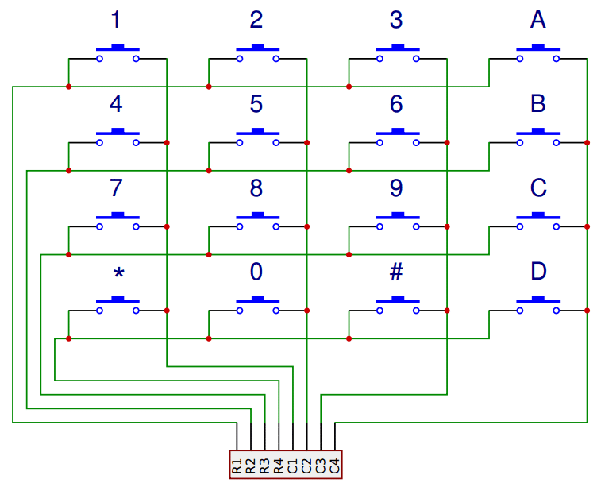
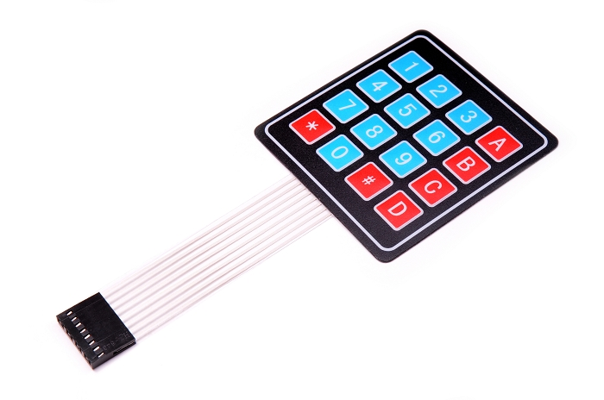
SENSOR TYPES
4x4 Membrane Switch Matrix Keypad
L

Slide 7
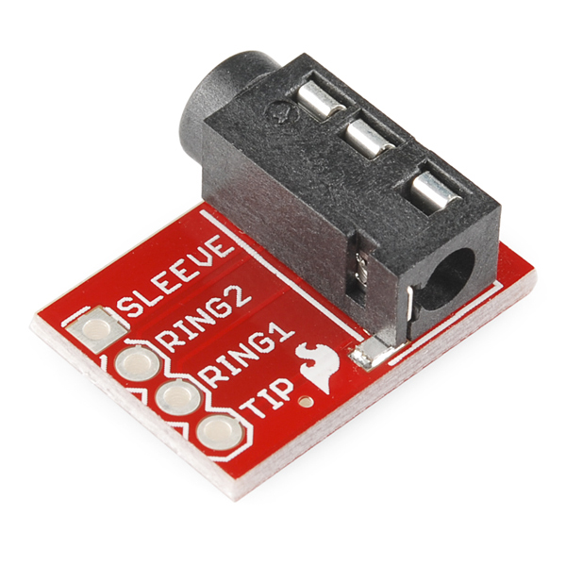
OUTPUT
DEVICES
Sparkfun TRRS 3.5MM Audio Jack
L

Slide 8
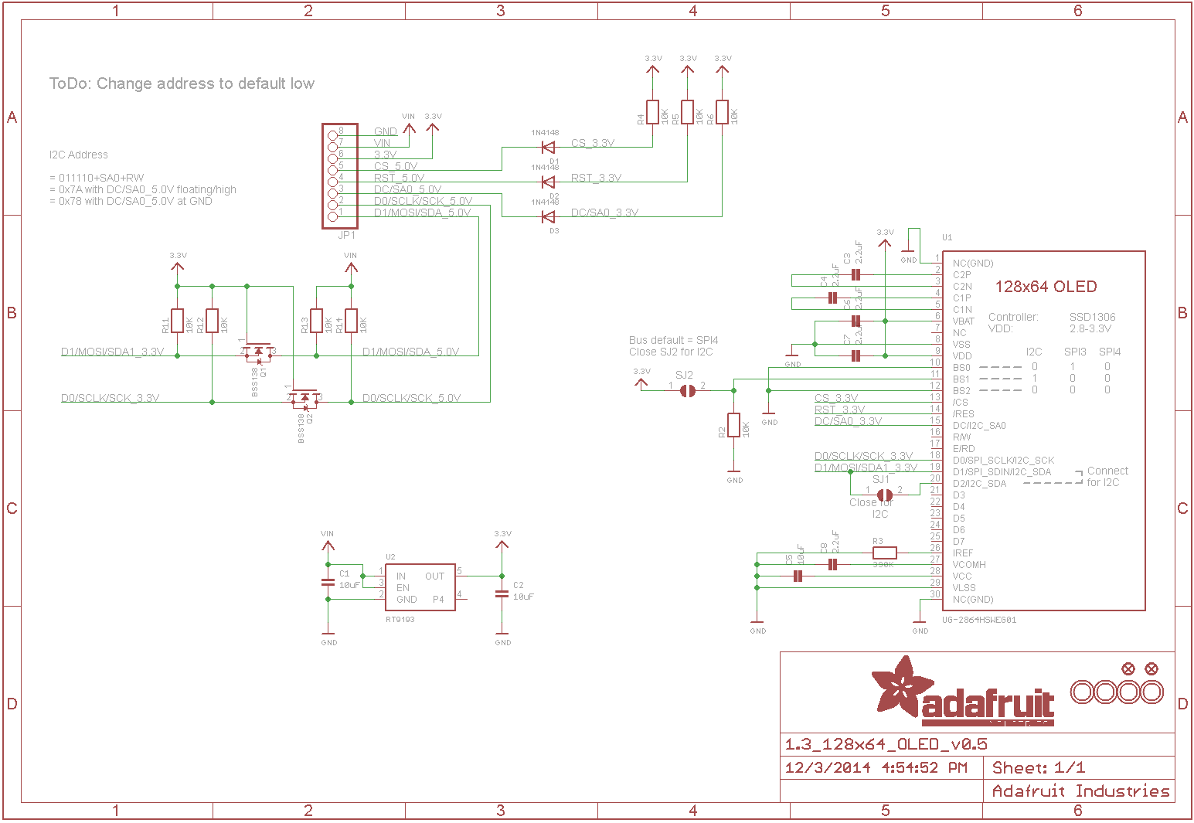
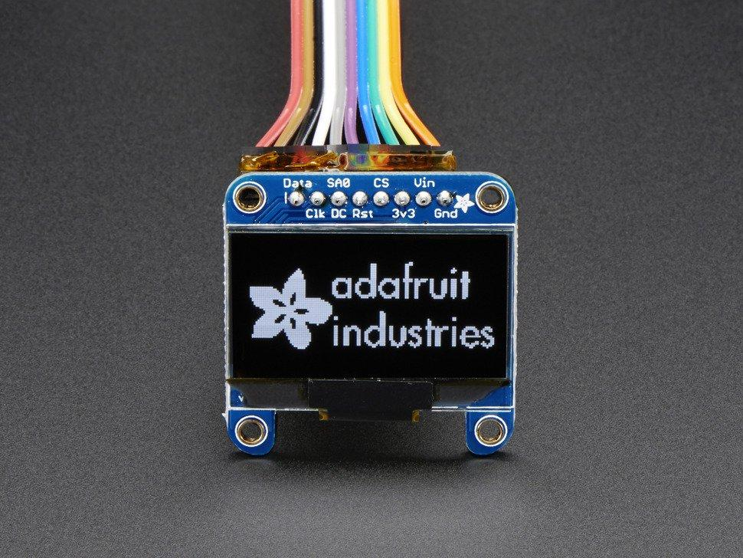
OUTPUT
DEVICES
Adafruit Monochrome 1.3” 128x64 OLED graphical Display
L

Slide 9
SOFTWARE
FUNCTIONS
audioIn
Takes in audio using a microphone amp
Uses ADC to convert analog inputs at 76.9 kHz
numPad
Controlling voice effects for corresponding sound
timer
Implements a precise millisecond delay
audioOut
Modulates the frequency and volume of that data
Uses PWM to manipulate audio input
screen
Displays images on OLED screen using I2C write command
N, L, JB

Slide 10
SOFTWARE
FUNCTIONS
waveModulator
Depending on what the user chooses on the numeric keypad, the frequency and volume of the input will be modulated
i2c
Serial protocol for two-wire interface, each pulled up to high voltage with a pull-up
N, L

Slide 11
COMMUNICATION PROTOCOL
Using I2C to output waveform data graph to the Monochrome 1.3” OLED Screen
Uses I2C 7-bit address between 0x3C-0x3D

Slide 12
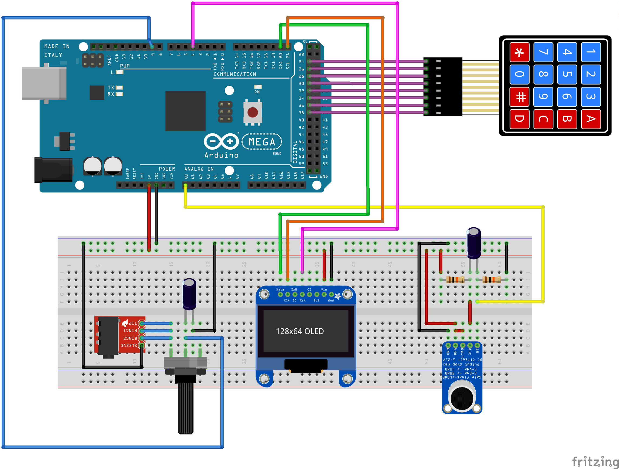
CIRCUIT DIAGRAM
L

Slide 13
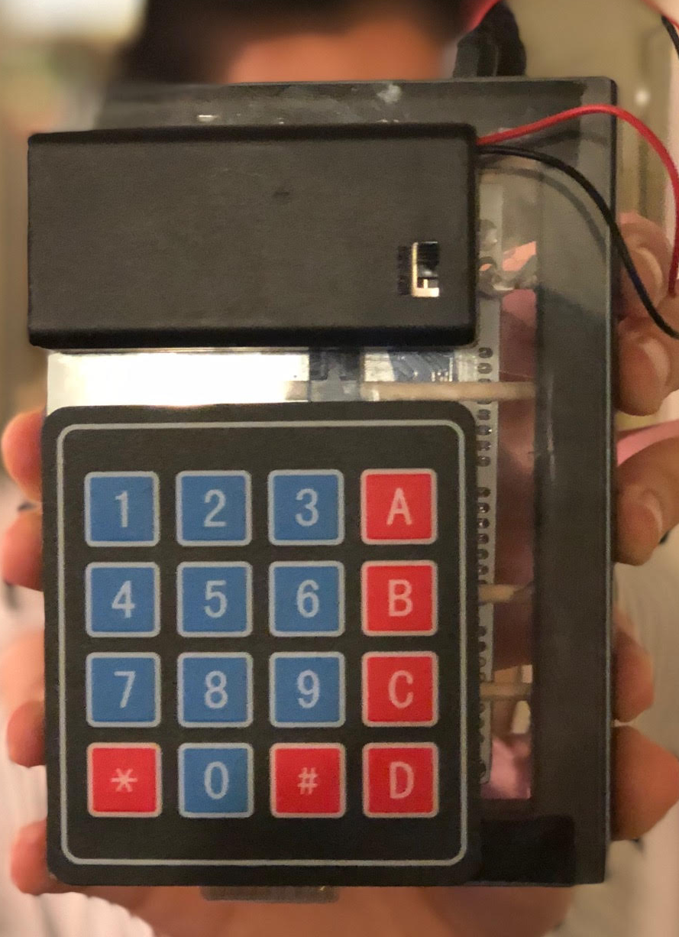
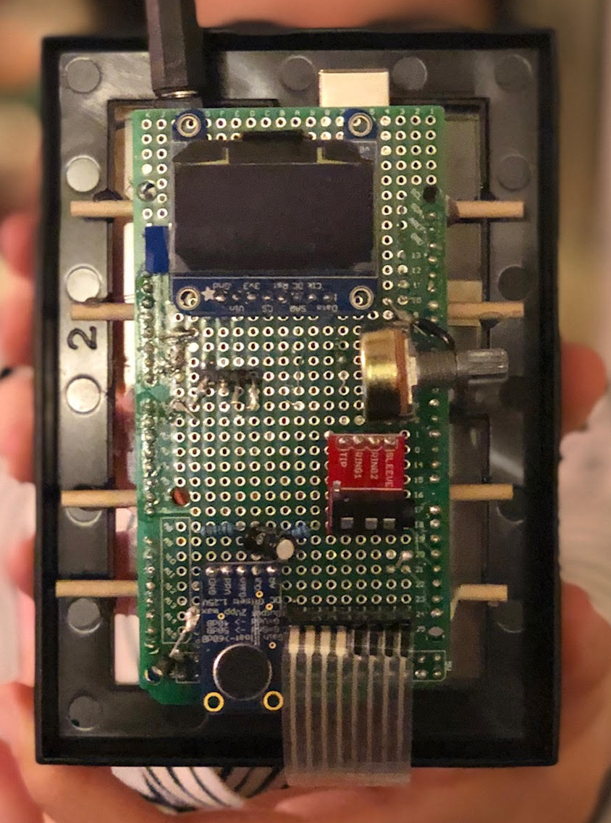
MECHANICAL DIAGRAM
OLED Screen
External Battery
Potentiometer
Audio Output
Number Pad
Audio Input
JS

Slide 14
BILL OF MATERIALS
COST
1
Microphone AMP
$7.95
2
Switch Matrix Keypad
$6.79
3
Adafruit Monochrome 1.3”
$19.95
4
3.5mm Jack
$7.99
5
Sunfounder AT Mega 2560
$13.99
6
Breakout Board
$7.99
TOTAL
$60.62
JS

Slide 15
Project Plans and Milestones
OLED Graphic Display
Keypad
3.11.19 - 4.02.19
3.11.19 - 4.15.19
3.11.19 - 4.24.19
3.11.19 - 4.24.19
Audio Passthrough
Microphone
JS

Slide 16
FINAL RUBRIC
4
3
2
1
4
Voice Input
Working
Any sort of sound
Voice Goes Into Controller
Not Working
3
Voice Manipulation
Working
Most frequencies work
Some frequencies work
Not Working
4
Number Pad
Working
Most inputs work
Some inputs work
Not Working
4
Display
Displays
Image Without
Delay
Displays Image With Delay
Displays Single
Image
Not Working
JS

Slide 17
SUMMARY
Project is almost complete
Working to add more input modulations while minimizing feedback
Audio passthrough could be improved
Currently uses internal ADC and PWM for manipulation
Standalone external ADC and DAC setup could be used
Future endeavor includes going from an 8-bit to 16-bit input/output
Working with an 8 bit input/output, which limits the functionality of the voice modulator
Minimize noise and speed up the process, unsigned character math was used
N

Slide 18
FUTURE ENDEAVORS
Standalone external ADC and DAC setup could be used
This will allow us to do more input modulations while minimizing the amount of feedback and noise.
By using an external ADC and DAC, we minimize the
Converting from 8-bit to 16-bit input/output

